Slide 2
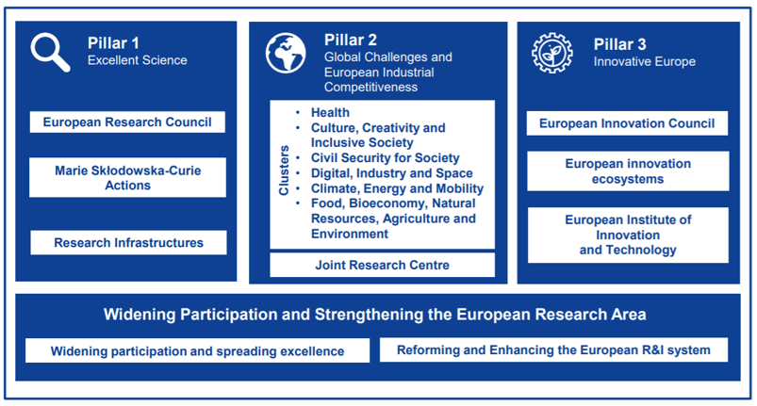

Slide 3
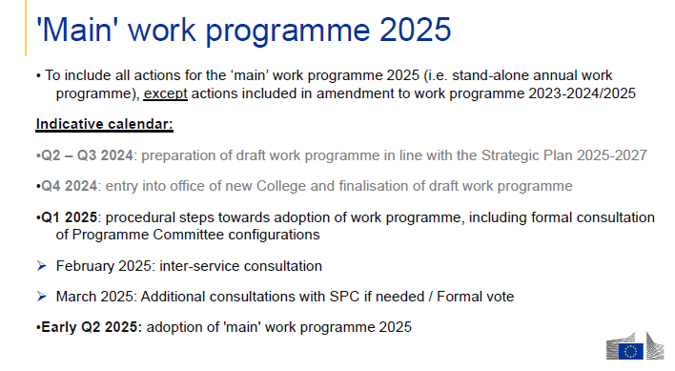
WP 2025
Publication: May 2025 - mainly

Slide 4
Lessons Learned from Horizon 2020 Interim Evaluation
Key Novelties
in Horizon Europe
Support breakthrough innovation
Create more impact through mission- orientation and citizens' involvement
Rationalise partnerships’ landscape
Reinforce openness
Strengthen international cooperation Encourage participation
European Innovation Council
EU Missions
New approach to partnerships
Open science policy
Extended association possibilities
Spreading Excellence

Slide 5
Budget Horizon Europe

Slide 7
A PROGRAMME IN THE HE PROGRAMME
PARTNERSHIPS | WHAT ARE THEY?
European partnerships are initiatives in which the European Union, national authorities and/or the private sector jointly commit to supporting the development and implementation of a programme of research and innovation activities.
Partners may represent industry, universities, research organisations, bodies with a public service mission at local, regional, national or international level, or civil society organisations, including foundations and NGOs.
Complementarity with the themes/Destinations of the Clusters
≠ consortium

Slide 8
EUROPEAN PARTNERSHIP

Slide 9
OLTRE 120 partenariati attivi in HORIZON in 2020

Slide 10
New approach to European Partnerships
PARTNERSHIPS
Co-funded
Institutionalised
Co-programmed
Co-programmed partnerships are based on joint programming of research and innovation activities and mobilisation of additional activities by partners in line with the objectives of the partnership. They are based on a Memorandum of Understanding, which the Commission signs with industry associations. The EU contribution is implemented through Horizon Europe work programme calls, while matching contributions from partners are implemented under their responsibility.
Co-funded partnerships fund joint programmes of research and innovation activities between research and innovation funders. They are implemented through Horizon Europe Grant Agreements signed by the Commission and a consortium of partners, generally composed of research and innovation funders and other public authorities. Partners generally implement joint transnational calls as well as additional activities, with either 30% or 50% co-funding from Horizon Europe.
Joint Undertakings (JUs) based on Article 187 of the Treaty on the Functioning of the EU (TFEU): long-term collaborations with private (sometimes also public) partners requiring a high degree of integration
Article 185 initiatives, based on Article 185 TFEU: long-term collaborations with public partners requiring a high degree of integration

Slide 11
HE European Partnerships (2021-2024)
Horizon Europe Pillar II - Global challenges & European industrial competitiveness
Pillar III - Innovative Europe
Cluster 1: Health
Cluster 4: Digital, Industry & Space
Cluster 5: Climate, Energy & Mobility
Cluster 6: Food, Bioeconomy, Agriculture, …
Eit (KNOWLEDGE & INNOVATION COMMUNITIES)
support to innovation ecosystems
Innovative Health Initiative
Key Digital Technologies
Clean Hydrogen
Circular Bio-based Europe
InnoEnergy
Innovative SMEs
Global Health Partnership
Smart Networks & Services
Clean Aviation
Rescuing Biodiversity to Safeguard Life on Earth
Climate
Transformation of health systems
High Performance Computing
Single European Sky ATM Research 3
Climate Neutral, Sustainable & Productive Blue Economy
Digital
Chemicals risk assessment
Europe’s Rail
Food
European Metrology (Art. 185)
Health
Connected and Automated Mobility (CCAM)
Water4All
ERA for Health
AI-Data-Robotics
Raw Materials
Animal Health & Welfare*
Rare diseases*
Photonics
Batteries
Manufacturing
Accelerating Farming Systems Transitions*
One-Health Anti Microbial Resistance*
Made in Europe
Zero-emission waterborne transport
Urban Mobility
Agriculture of Data*
Cultural and Creative Industries
Personalised Medicine*
Clean steel – low-carbon steelmaking
Zero-emission road transport
Safe & Sustainable Food System*
Pandemic Preparedness*
Processes4Planet
Built4People
Global competitive space systems**
Clean Energy Transition
+ PRIMA
Cross-Pillars II & III
Driving Urban Transitions
European Open Science Cloud
Institutionalised Partnerships (Art 185/7)
Institutionalised Partnerships / EIT KICs
Co-Programmed
* Calls with opening dates in 2023-24
** Calls with opening dates not before 2022
Co-Funded

Slide 12
You can find all the information about European Partnerships at the link below
https://tinyurl.com/5n97emta

Slide 15
Missions Work Programme - https://tinyurl.com/yt6ntn9h

Slide 16
WP 2025 UPDATE

Slide 17
Pillar I – Calls 2025
Thematic Area | Call | Calls opening | Calls closure
ERC | Starting Grant STG 2025 | 10/07/2024 | 15/10/2024
 | Consolidator Grant CoG 2025 | 26/09/2024 | 14/01/2025
 | Advanced Grant ADG 2025 | 22/05/2025 | 29/08/2025
 | Synergy Grant SYG 2025 | 11/07/2024 | 06/11/2024
MSCA | Call - MSCA Doctoral Networks 2025 | 28/05/2025 | 25/11/2025
 | Call - MSCA Postdoctoral Fellowships 2025 | 09/04/2025 | 10/09/2025
 | Call - MSCA Staff Exchanges 2025 | 27/03/2025 | 08/10/2025
 | Call - MSCA COFUND 2025 | 23/01/2025 | 24/06/2025
 | Call - MSCA and Citizens 2025 | 17/06/2025 | 22/10/2025
RIs | Tutte le destination | 06/05/2025 | 18/09/2025
Notes:
RI: Per tutte le call 5 /destination (aggiornata al 22 ottobre) next comitato Aprile 25

Slide 18
Pillar I – Calls 2025
Thematic Area | Call | Calls opening | Calls closures
Cluster 1 Health | Bandi Single stage | 22/05/2025 | 18/09/2025
 | Bandi Two stage | 22/05/2025 | 18/09/2025 (First Stage) 16/04/2026 (Second Stge)
Cluter 2 Culture, Creativity and Inclusive society | Tutti i bandi | 15/05/2025 | 16/09/2025
Cluster 3 Civil Security for Society | Tutti i bandi | 12/06/2025 | 12/11/2025
Cluster 4 Digital, Industry and Space | Bandi Industry | 22/05/2025 | 23/09/2025
 | Bandi Digital | 10/06/2025 | 02/10/2025
 | Bandi Space | 03/06/2025 | 04/09/2025
Notes:
RI: Per tutte le call 5 /destination (aggiornata al 22 ottobre) next comitato Aprile 25

Slide 19
Pillar II – Calls 2025
Thematic Area | Call | Calls opening | Calls closure
Cluster Climate, Energy and Mobility | Call 01-2025 (WP 2025) [D5, D6] | 06/05/2025 | 04/09/2025
 | Call 02-2025 (WP 2025) [D2, D3] | 06/05/2025 | 16/09/2025
 | Call 03-2025 (WP 2025) [D1, D2] | 06/05/2025 | 24/09/2025
 | Call 01-2026 (WP 2025) [D2,D5, D6] | 16/09/2025 | 13/01/2026
 | Call 02-2026 (WP 2025) [D3,D4] | 16/09/2025 | 17/02/2026
Cluster 6 Food, bioeconomy, natural resources, agriculture and environment | Call 01 – single stage HORIZON-CL6-2025-01​[ D1, D3, D4] | 06/05/2025 | 17/09/2025
 | Call 02 – single stage HORIZON-CL6-2025-02​[D2, D5, D6]] | 06/05/2025 | 16/09/2025
 | Call 03 – single stage HORIZON-CL6-2025-03​ [D7] | 06/05/2025 | 24/09/2025
 | Call 01 – two-stage​ [D1, D3, D4] HORIZON-CL6-2025-01-two-stage​ ​ | 06/05/2025 | 4/09/2025 (First stage) 18/02/2026 (Second Stage)
 | Call 02 – two-stage​ [D2, D5] HORIZON-CL6-2025-02-two stage​​ | 06/05/2025 | 4/09/2025 (First stage) 18/02/2026 (Second Stage)
Notes:
RI: Per tutte le call 5 /destination (aggiornata al 22 ottobre) next comitato Aprile 25

Slide 20
Pillar II – Calls 2025
Thematic Area | Call | Call sopening | Calls closure
EU Missions | HORIZON-MISS-2025-01 [Adaptation to Climate Change] | 06/05/2025 | 24/09/2025
 | HORIZON-MISS-2025-02 [Cancer] | 06/05/2025 | 18/05/2025
 | HORIZON-MISS-2025-03 [Ocean and Waters] | 07/05/2025 | 24/09/2025
 | HORIZON-MISS-2025-04 [Smart Cities] | 06/05/2025 | 04/09/2025
 | HORIZON-MISS-2025-05 [Soil] | 06/05/2025 | 24/09/2025
NEB | HORIZON-NEB-2025-01 | 06/05/2025 | 12/11/2025
Notes:
RI: Per tutte le call 5 /destination (aggiornata al 22 ottobre) next comitato Aprile 25

Slide 21
Pillar III – Calls 2025
Thematic Area | Call | Calls opening | Calls closure
EIC European Innovation Council | EIC PATHFINDER OPEN | 20/02/2025 | 21/05/2025
 | EIC PATHFINDER CHALLENGE | 28/07/2025 | 29/10/2025
 | EIC TRANSITION | 04/2025 | 17/09/2015
 | EIC ACCELERATOR OPEN/CHALLENGES: | short proposal sempre aperta | [Short proposal] sempre aperta [Full proposa]: 12/03/2025 e 1/10/2025
 | EIC STEP SCALE UP | 26/11/2024 | Sempre aperta
Notes:
RI: Per tutte le call 5 /destination (aggiornata al 22 ottobre) next comitato Aprile 25

Slide 22
WIDERA– Calls 2025
Thematic Area | Call | Calls opening | Calls closure
WIDERA | Call - European Excellence Initiative (EEI) | 08/05/2025 | 20/11/2025
 | Call - EIC pre-accelerator - Widening | 06/05/2025 | 16/09/2025
 | Call - Hop-on facility | 06/05/2025 | 4/09/2025
 | Call - Support for R&I policy making in the EU enlargement countries | 06/05/2025 | 16/09/2025
 | Call - Enhancing the European R&I system | 15/05/2025 | 02/10/2025
Notes:
RI: Per tutte le call 5 /destination (aggiornata al 22 ottobre) next comitato Aprile 25

Slide 23
Key Elements
Two stage topic | Cluster 1, Cluster5, Cluster 6 New: Cluster 2 Blind evaluation in nel first stage Open topic nel CL5 e CL6 (Farm2fork e CIRC BIO) Topic high levels of participation (CL1, Cl6)
China | No Innovation Action Statement: Legal entities established in China are not eligible to participate in Innovation Actions in any capacity. Cluster 4, Cluster 5, Cluster 6, Mission Cluster 1 D6 –IND Maintaining an innovative, sustainable, and competitive EU health industry
Specificità | Cluster 1: Pilot su gender balance ex aequo proposal (D1, one topic) Cluster 3: Open topic topic ECCC (EU cybersecurity compence center Cluster 4: New destination MATERIALS sostituisce RESILIENCE and new partnership co programmed «im4eu» e Textile Topic INDUSTRY nelle destination DIGITAL (D4, D6) Cluster 5: art. 22.6. (protection against high-risk suppliers) → 36 topic

Slide 24
TEMA | DATA - Info day EU | DATA - Brokerage event EU
EU Missions | 22-23 may | online | 26 may | online
Cluster 1 – Health | 22 may | online | 5-6 may | online
Cluster 2 – Culture, Creativity & Inclusive Society | 15 may | online | 16 may| online
Cluster 3 – Civil Security for Society | 11 june | onsite, Brussels | 12 june | onsite, Brussels
Cluster 4 – Digital, Industry & Space | 13-14 may | online | 15 may | onsite, IndTech 2025 (Krakow)
Cluster 5 – Climate, Energy & Mobility | 6 may | onsite | 6 may | onsite
Cluster 6 - Food, Bioeconomy, Natural Resources, Agriculture & Environment | 20-21 may | online | 27 may | onsite, Warsaw
WIDERA | 20 may | online

Slide 25
Brokerage events:
https://b2match.com/e/care4bio-2025

Slide 26
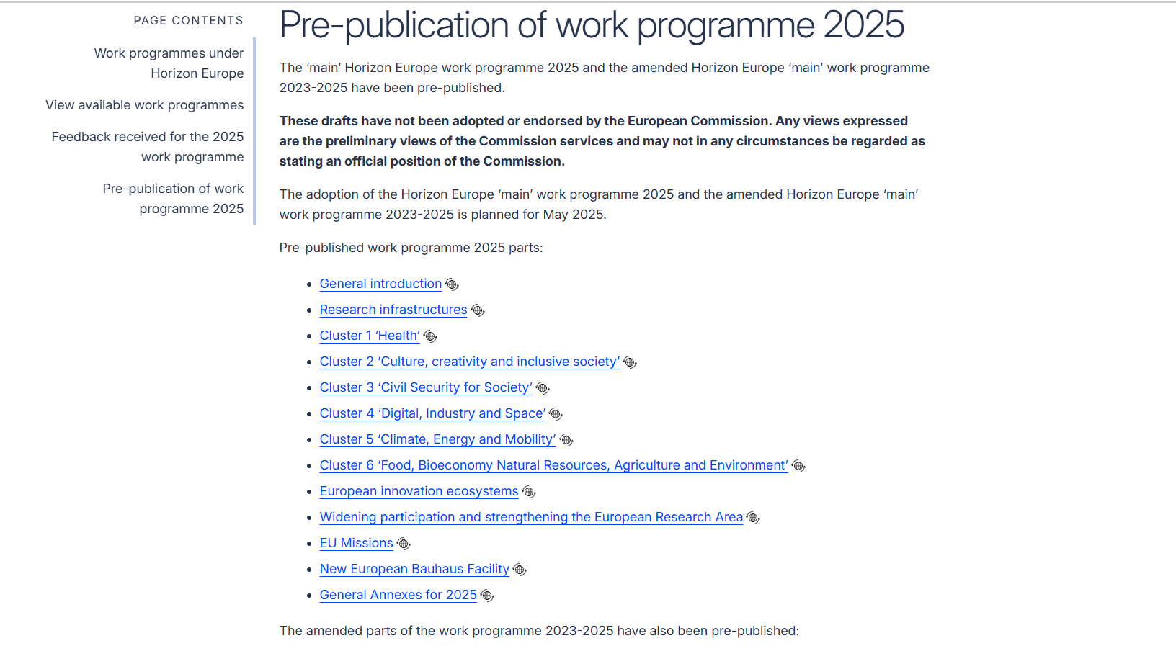
Horizon work programmes for 2025 show clear shift to competitiveness
An official pre-publication of draft documents outlines €7.2 billion in calls for proposals backed by simpler administration
https://tinyurl.com/wy7bsdjx

Slide 27
DRAFT ORIENTATION WP 2026-27

Slide 28
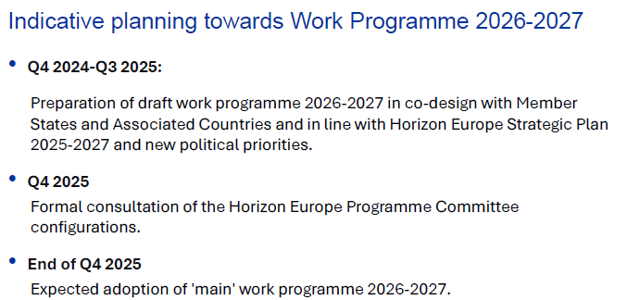
WP 2026-2027
Content Definition

Slide 29
Science Business Papers
https://sciencebusiness.net/horizon-papers
2026-27 Draft Orientation
Cities Mission: January 2025
Culture, Creativity and Inclusive Society: workshop destination 1, workshop destination 2, workshop destination 3
Widening: February 2025
ERA: February 2025
Climate, energy and mobility: draft orientations February 2025
Climate adaptation Mission: topic ideas February 2025

Slide 30
Some Considerations
Draft Orientations bridge from Strategic Plan 2025-2027 to (unknown) WP 2026-2027
= working document intended for stimulating discussion with PC and to concretise priorities for the next WP
Sets out expected impacts, outcomes and links to relevant policy framework (no topic discussion)
No ‘next version’ – discussion will feed the preparation of work programme drafts
Number of stated impacts and outcomes is no indicator for the number of topics nor the budget allocation between the areas. The Commission reserves its right to remove, add or modify impacts/outputs in the first draft WP.

Slide 31
Towards WP 2026-2027 | Simplification
Simplification is high political priority (Mission letter, Draghi Report, Heitor Report)
Less prescriptive, more open and bottom-up topics, giving applicants more flexibility and creativity to tackle the challenges of the R&I actions
Reduced number of topics
Priorisation of a limited number of strategic priorities
Shorter topic texts
Increase in number of projects funded per topic and average grant size per project
Target of 50% of call budget implemented as lump sums by 2027 remains
More use of 2-stage evaluations

Slide 32
THANK YOU FOR YOUR ATTENTION

